Slide 1


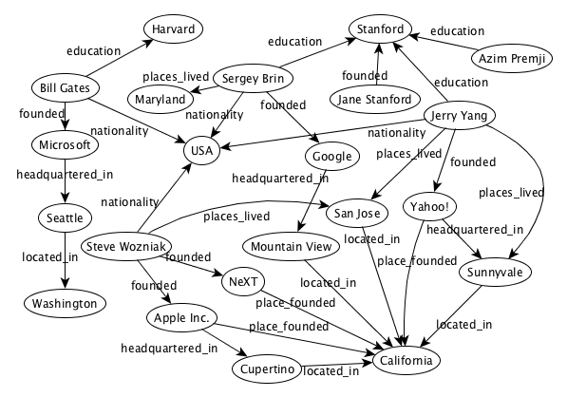
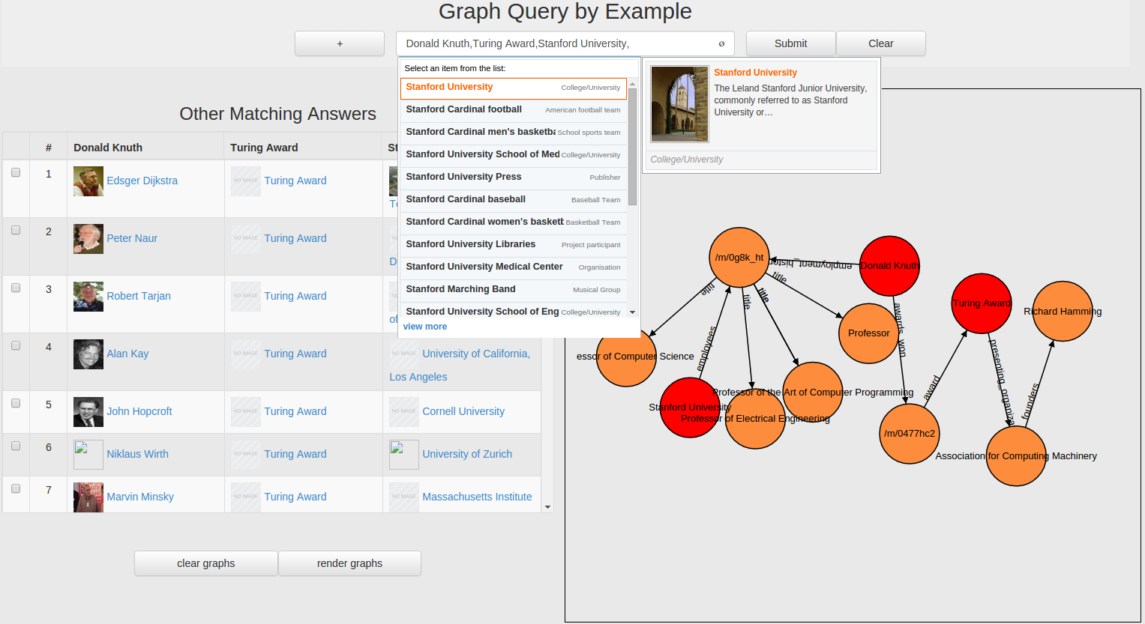
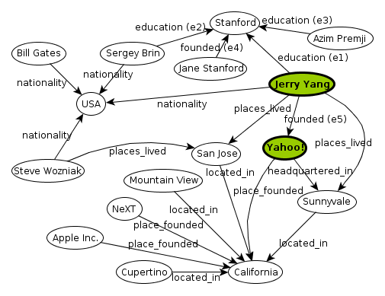
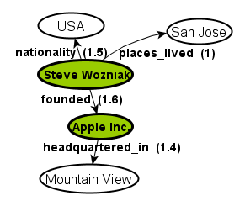
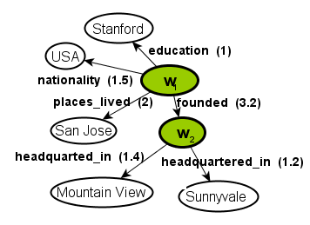
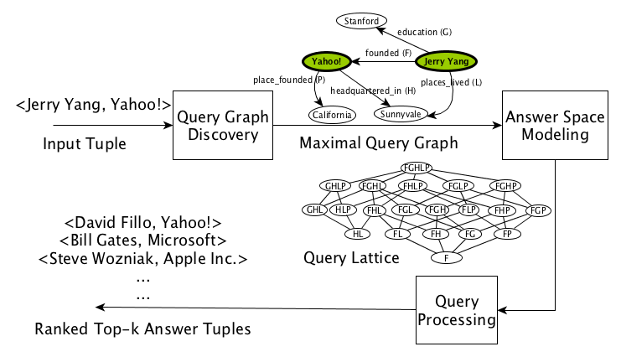
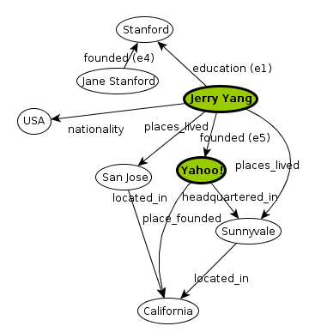
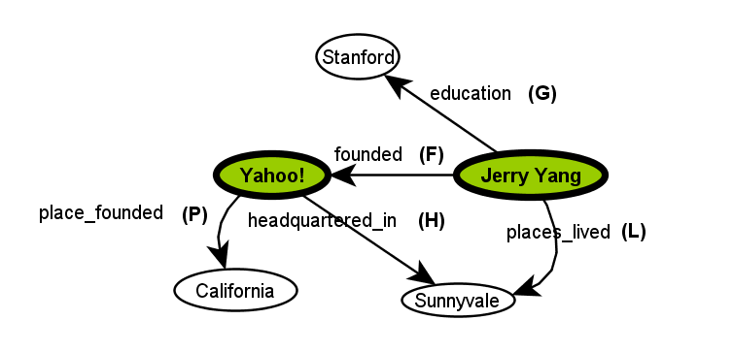
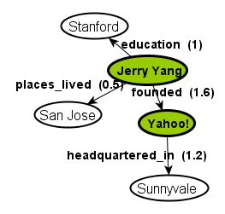
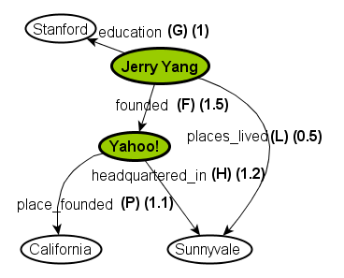
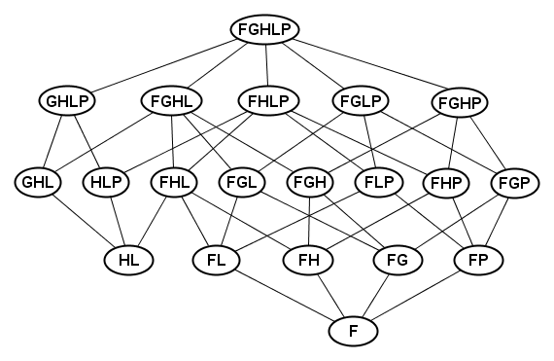
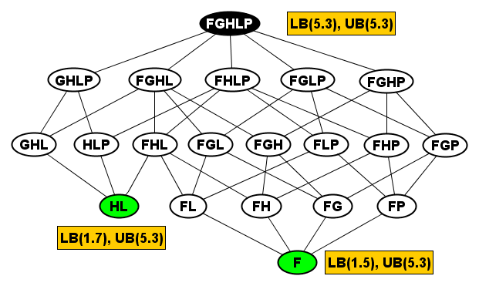
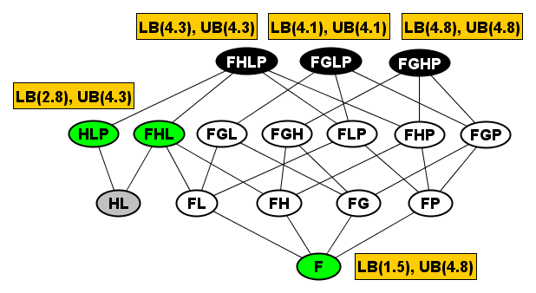
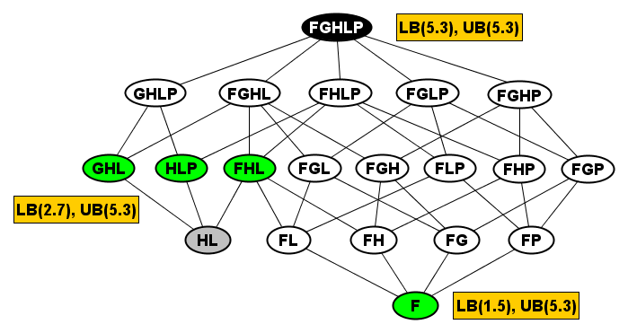
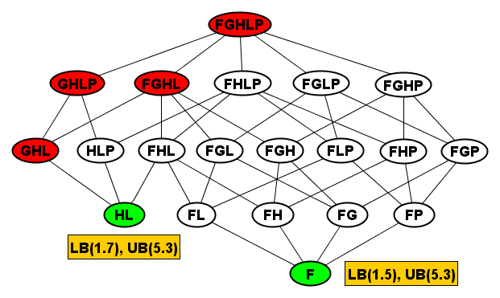
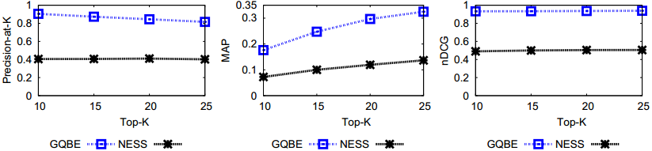
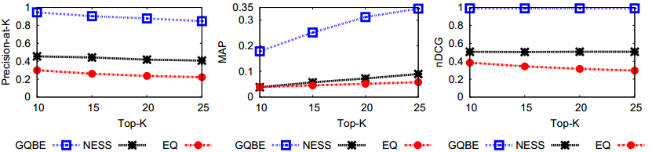
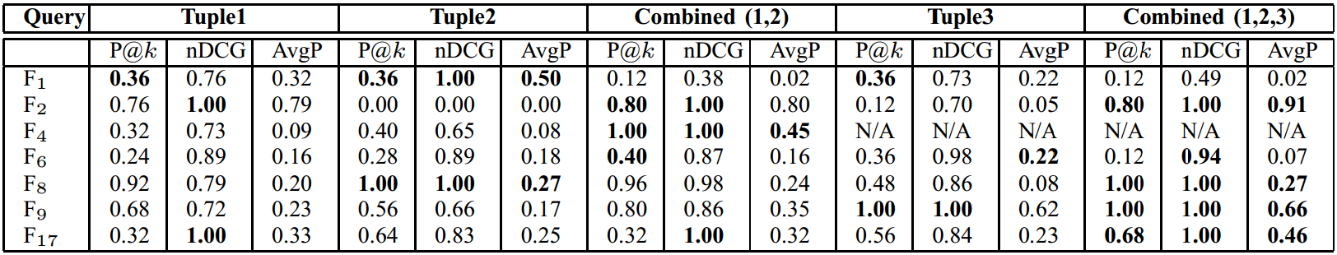
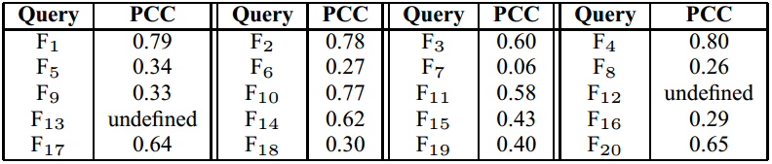






Querying Knowledge Graphs by Example Entity Tuples
Nandish Jayaram ¹⁺ , Arijit Khan ²*, Chengkai Li ¹, Xifeng Yan ², Ramez Elmasri ¹
University of Texas at Arlington¹ University of California, Santa Barbara²
Knowledge Graphs
Usability Challenges
Query Interface
Big and complex data: Lack of schema, challenging to users and developers.
How to query the graph, and understand the results.
Related Work
Query-by-example in relational databases [Zloof’75].
Keyword search and keyword-based query formulation [Chang et al.’11].
Set expansion [Wang et al.’07]. XML query relaxation [Amer-Yahia et al.’2005].
Exemplar queries [Mottin et al., 2014].
GQBE Architecture
Query Graph Discovery
Multi-Tuple Query Graphs
Input: an example of what the user wants to find.
Weight edges using heuristics and use a greedy approach to obtain a smaller connected MQG.
Query Graph 1
Query Graph 2
Obtain neighborhood graph.
Multiple MQGs are merged based on edge labels and vertex label matches.
Answer Space Modeling
Query Processing
Initial Lattice
Upper Bound (UB): score of the highest-scored super-graph in the lattice.
Modified lattice with recomputed upper boundary
All the super-graphs of a null node are pruned.
Nodes (F) and (HL) are two minimal query trees.
Node (F) corresponds to the sub-graph that connects Jerry Yang and Yahoo through edge founded.
Node (FGHLP) is the MQG, and it corresponds to the entire query graph on the left.
Lower Bound (LB): edge matching score of the corresponding graph.
(GHL), a node that does not have any answers, is a null node.
Experiments
DATASETS: Freebase (28 M nodes, 47 M edges, 5400 relationships) DBpedia (759 K nodes, 2.6 M edges, 9100 relationships)
QUERIES: 20 Queries on Freebase 8 Queries on DBpedia
Ground truth based accuracy comparison of GQBE and NESS. Comparison of GQBE, NESS and Exemplar Queries. The measured parameters are precision-at-k, Mean Average Precision and normalized Discounted Cumulative Gain.
Query processing time for 2-tuple queries.
Pearson Correlation Coefficient (PCC) between GQBE and Amazon Mechanical Turk Workers, for k=30. MTurk workers were presented with answer pairs and asked for their preference between the two answers in each pair. 20000 such opinions collected.
Accuracy of GQBE on multi-tuple queries, k = 25.
Technical Details and Demo
N. Jayaram, A. Khan, C. Li, X. Yan and R. Elmasri. Querying knowledge graphs by example entity tuples, TKDE 2015.
N. Jayaram, M. Gupta, A. Khan, C. Li, X. Yan and R. Elmasri. GQBE: Querying knowledge graphs by example entity tuples, ICDE 2014.
Demo URL: http://idir.uta.edu/gqbe
Query processing times of GQBE, NESS and Baseline.
Lattice nodes evaluated comparison.
Partially funded by:
⁺Now with Pivotal, *Now with Nanyang Technological University, Singapore

